Slide 1
Zero Trust Design Using Cloud Native Computing Foundation (CNCF) Landscape
Design Project
1

Slide 2
Agenda
1
Introduction
Context / Situation.
6
Concepts of Operations
Tools utilized in the project.
2
Importance of ZTA in Cybersecurity
Explaining Zero Trust (ZT) principles
Introduce CNCF security tools
7
Methodology and Research Design
Parallel investigation of Azure and local VMs.
Major research points.
3
Stakeholders
List of all individuals, groups, or organizations that have an interest or concern in the project.
8
Implementation
Demo & visuals showcasing ZTA aspects in both the paper and the presentation.
4
Problem Statement
Brief description of the challenge that needs to be solved
9
Verification & Validation
Ensure that the research and is connected to ZT principles.
Demonstrate how work ties back to ZT principles
5
Requirements
The necessary components and expertise needed to implement the solution.
10
Application and Lessons Learned
How organizations can utilize the research findings
Lessons learned to transition towards a ZTA approach.

Slide 3
Introduction
Rising Need for Cybersecurity in Cloud-Native Environment
Traditional perimeter-based security model inadequate for modern threats
Zero Trust Architecture (ZTA) crucial amid cloud service proliferation
Example: Microsoft Exchange Server Vulnerabilities (2021)
Microsoft Exchange Server vulnerabilities led to unauthorized email access and potential malware installation
Highlighting the need for ZTA principles like continuous verification and least privilege access to prevent such breaches
https://rb.gy/y14krb

Slide 4
ZTA Integration
Integration of ZTA with CNCF Landscape
CNCF offers open source security tools
Research focuses on merging ZTA principles with CNCF tools
Utilization of Azure platform and CNCF tools (Envoy, Vault, SPIFFE/SPIRE) in simulated cloud environment
Demonstrates efficacy in securing cloud service communications through access controls and validation mechanisms (like nmap).

Slide 5
Importance of ZTA in Cybersecurity
Trust/Verify Paradigm
Multi-Factor Authentication & Encryption
ZTA emphasizes the principle of "Never trust, always verify,"[1] ensuring continuous authentication of access requests regardless of user location or network environment.
ZTA incorporates robust security measures such as MFA and encryption to protect critical data, reducing the risk of unauthorized access and data breaches.
Micro-segmentation
Identity and Access Management (IDAM)
ZTA employs micro-segmentation to minimize the attack surface, preventing lateral movement of potential attackers within the network and enhancing overall security posture.
ZTA shifts from perimeter-based defenses to granular access controls, enhancing security by closely managing user identities and permissions.

Slide 6
Problem Statement
Proprietary Zero Trust (ZT) products like Zscaler and Okta are too expensive for many organizations. However, open-source alternatives within the Cloud Native Computing Foundation (CNCF) offer robust cybersecurity solutions without hefty costs. By embracing CNCF's open-source offerings, we can make effective cybersecurity accessible to organizations of all sizes and budgets.

Slide 7
Stakeholders
Users and administrators of cloud-native applications
Decision-makers responsible for cybersecurity strategy within organizations
Cloud service providers like Azure
Entities concerned with regulatory compliance and risk management
MITRE, the company sponsoring the project
The mentors and resources needed for the project, from George Mason University (GMU)

Slide 8
Requirements
To effectively implement the project, the following requirements must be met:
Comprehensive Understanding of ZTA Principles
Exploration and Research of CNCF Tools
Effective Implementation and Verification of CNCF Tools
Relating Results to ZTA Principles
Dissemination of Research Findings
By adhering to these requirements, the project aims to contribute significantly to the understanding and implementation of ZTA principles and CNCF tools within the industry.

Slide 10
Methodology & Research Design
Methodology
Research and Analysis:
Studied Zero Trust principles and adapted them to the cloud environment.
Conducted a systematic analysis of open-source technologies available within the CNCF Landscape to identify suitable tools for implementing Zero Trust Architecture (ZTA).
Architecture Design, Prototype Development, and Deployment:
Designed a custom Zero Trust Architecture tailored to the cloud environment, specifying the integration of SPIFFE_SPIRE, Vault, Envoy, and visualized data through the use of Splunk.
Developed and deployed a prototype ZTA system into the production cloud environment, integrating ZTA components with existing cloud infrastructure and services.
Testing, Validation, and Evaluation:
Performed security assessments using tools like Nmap to identify vulnerabilities and ensure compliance with security policies.
Evaluated the performance and security of the implemented ZTA, iterating on the design and implementation to address any identified issues or enhancements specific to the cloud environment.
Documentation:
Documented the ZTA architecture, configurations, and integration points specific to the cloud environment to ensure comprehensive understanding and maintainability of the system.

Slide 11
Initial Environment Set-up
Research Design
A Hybrid Cloud environment hosted locally and in Azure.
The local component includes two Ubuntu VMs loaded on VirtualBox.
The Azure component consists of two Ubuntu VMs in the same Vnet hosted in Azure.
The two environments have interconnectivity.
pfSense- S2S VPN connection

Slide 12
Final Environment Set-up
Research Design
Spire Server

Slide 13
Implementation
Technical Depth and Demonstration

Slide 14
SPIRE
Security application consisting of a SPIRE server and agent used to register workloads and retrieve SVIDs.
Uses SVIDs for secure authentication between cloud services.
Unique verifiable SPIFFE IDs are created for services registered to the SPIRE server.
Typical deployments consist of a SPIRE server and multiple SPIRE agents.
The SPIRE Server:
Generates and distributes the SPIFFE IDs.
Registers workloads.
Attests nodes.
Signs keys.
SPIRE Agents:
Retrieve SPIFFE IDs and store them until they are needed by a workload.
Attest the identity of a workload.
Supply the workload with its SPIFFE ID.

Slide 15
SPIRE Demo
Link: SPIRE Demo

Slide 16

Vault
Used by applications that need to transmit data securely to store the keys and certificates.
Comprehensive secrets management solution.
Centralizes the storage, issuance, management of sensitive credentials such as:
Tokens
Passwords
Certificates
Encryption keys
Incorporates tight access controls, sophisticated leasing and renewal mechanisms, and detailed audit logging.
Vault's API-driven approach allows seamless integration with other services and applications, thereby enhancing automation and scalability in a cloud ecosystem

Slide 17
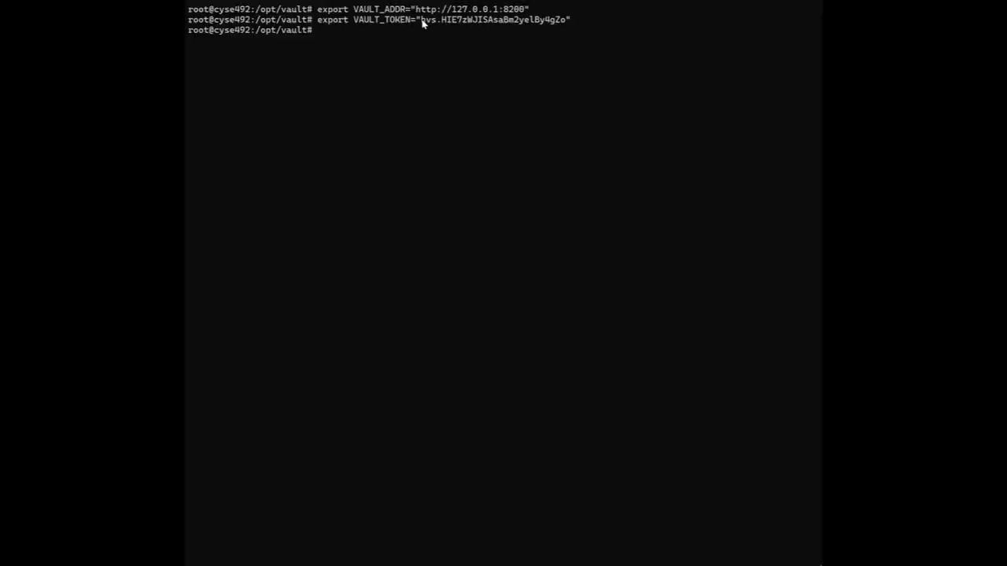
Vault Demo
Link: Vault Demo

Slide 18

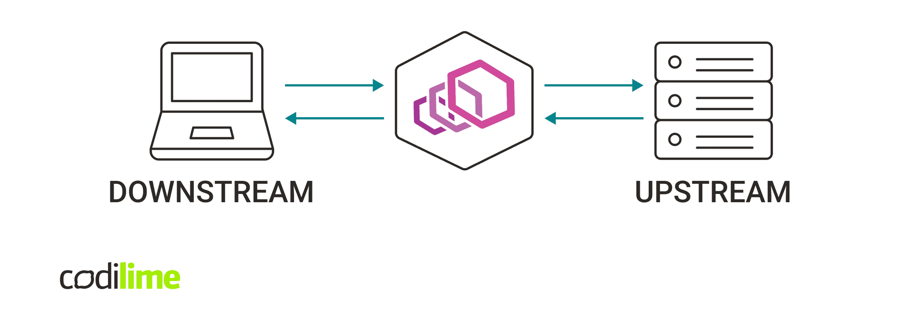
Envoy
Serves as a high-performance, cloud-native proxy that plays a crucial role in implementing mutual TLS (mTLS) for secure service-to-service communication within a Zero Trust architecture.
Has sophisticated service mesh capabilities that allow it to forge verified communication tunnels, leveraging the SPIFFE IDs from SPIRE to ensuring authentication and encryption.
Most deployments use it as a service mesh proxy that facilitates service to service communications securely using mTLS

Slide 19

Envoy Demo
Link: Envoy Demo

Slide 20

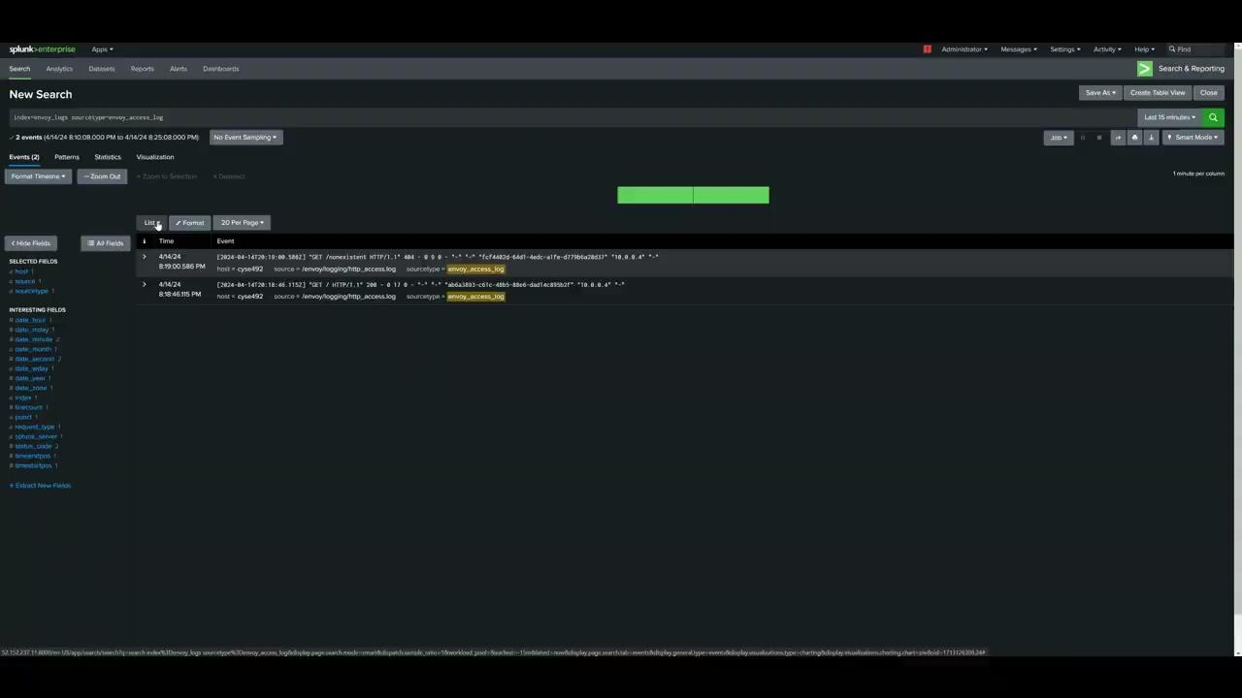


Visualizing Our Data
We Used:
CNCF Alternatives:
Link: Splunk Demo

Slide 21
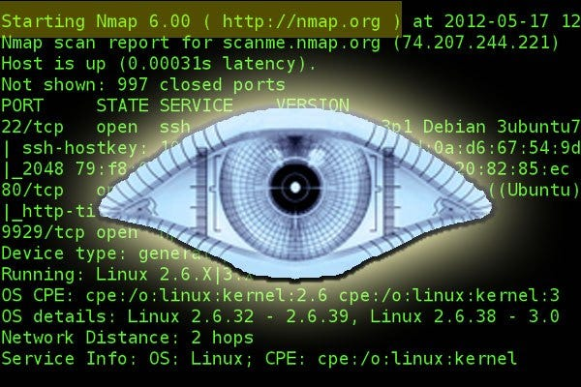
Verification & Validation
We verified and validated our solutions by conducting tests and experiments with Nmap. This included tests for the functionality of CNCF tools in enforcing Zero Trust principles, evaluating the effectiveness of access controls and validation mechanisms, and ensuring compliance with security standards and best practices.
Additionally, we solicited feedback from stakeholders (MITRE & mentor professor) and incorporated their input to refine our solutions further.

Slide 22
Nmap
Why Nmap?
Nmap helps scanning cloud VMs on Azure due to its versatility, open-source nature, and cross-platform compatibility.
It offers comprehensive scanning techniques, scripting capabilities, and potential integration with Azure for network security assessments. However, adherence to Azure's security policies is crucial when using Nmap in Azure environments.
https://shorturl.at/ginX5

Slide 23
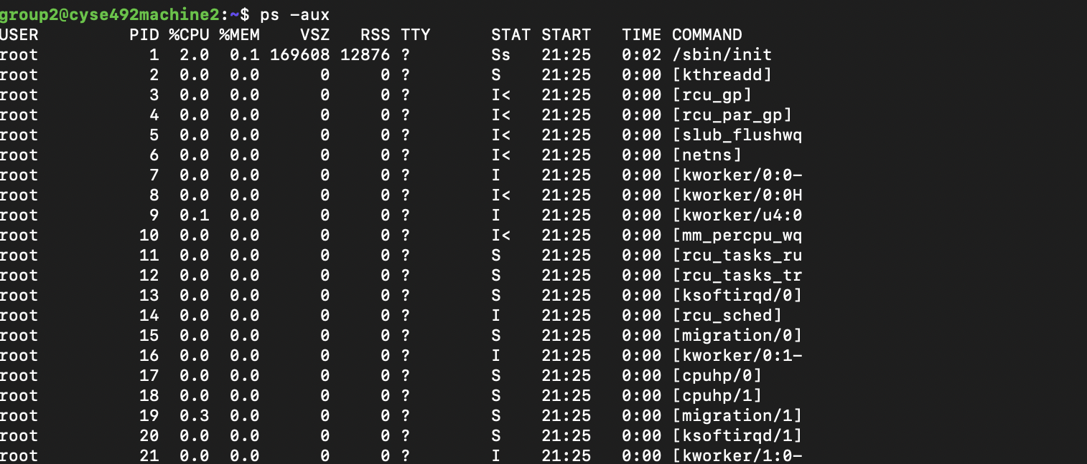
Nmap
Checking for user availability

Slide 24
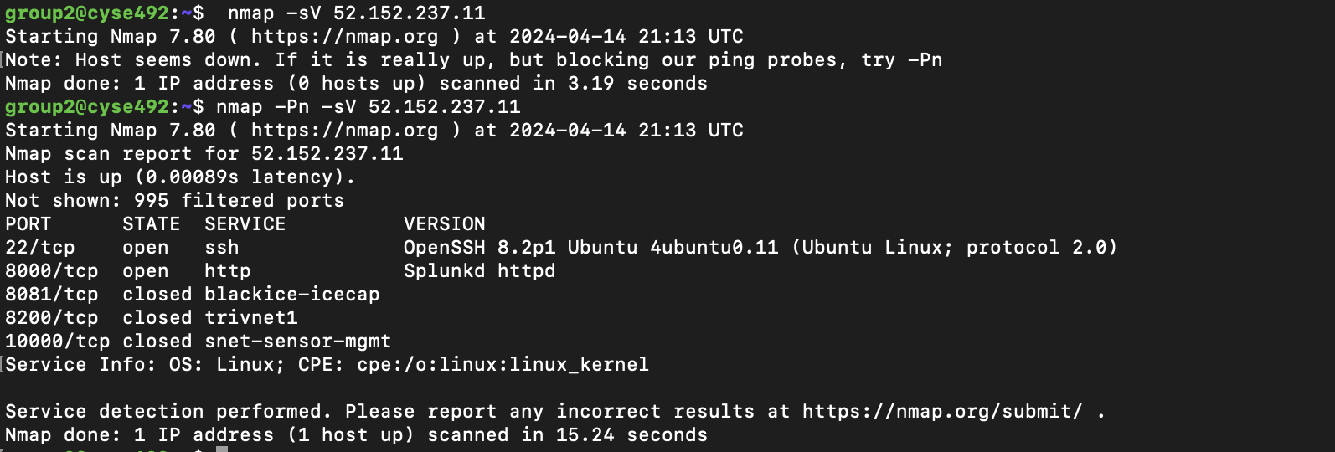
Nmap Scans
TCP SYN “-sS nmap IP”
TCP connect “-sT nmap IP”
Version detection “-sV nmap IP”
UDP “-sU nmap IP”

Slide 25
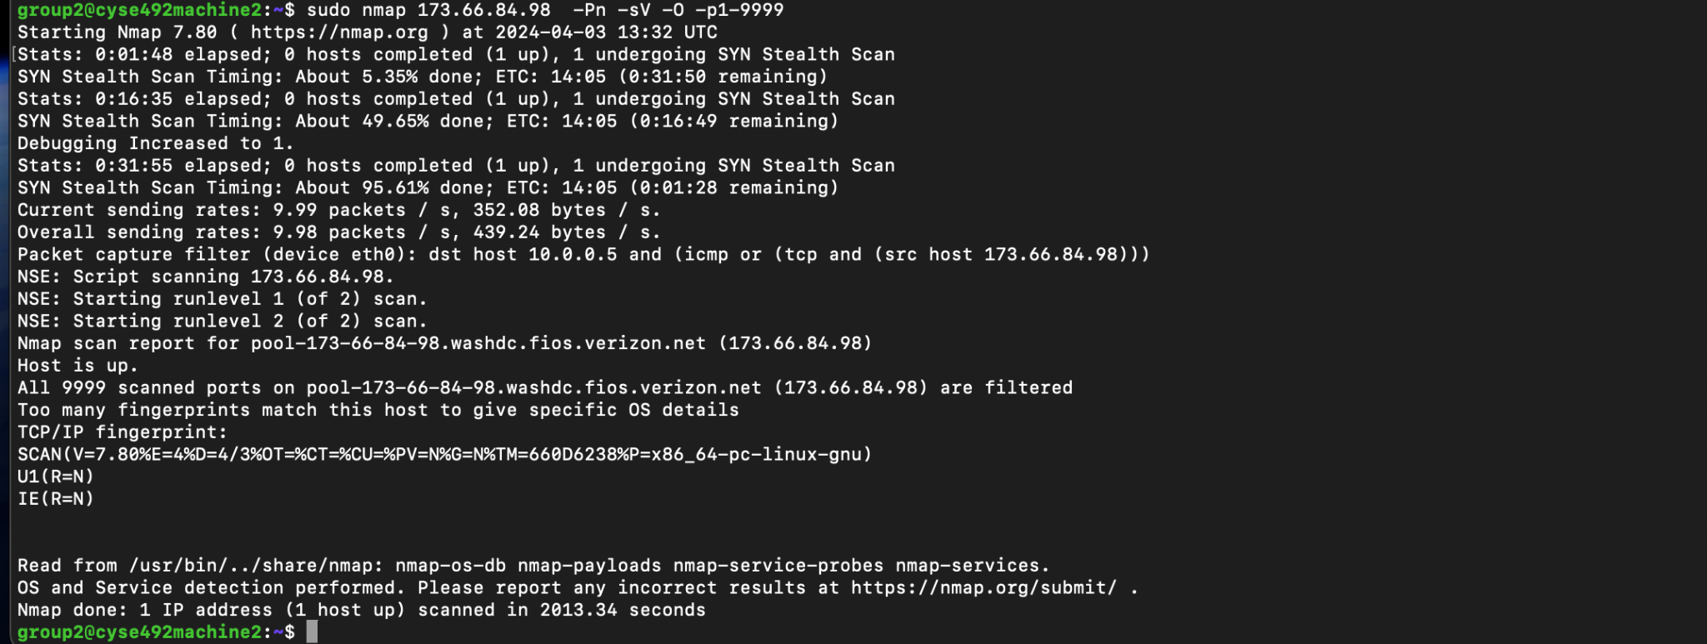
Nmap Penetration Testing

Slide 26
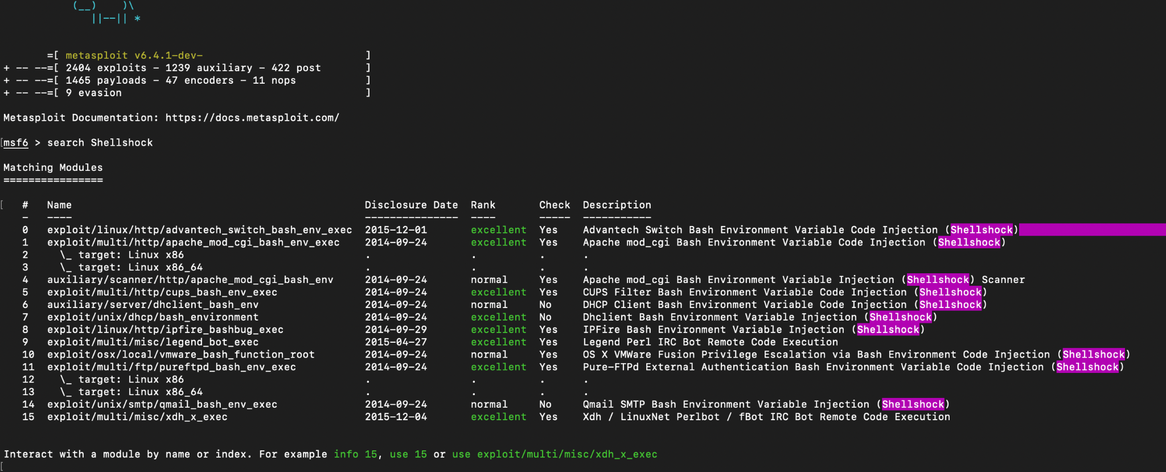
Penetration Testing

Slide 27
Connection & Relevance to ZTA Principles
The Cloud-Based VM Setup within the Azure Environment enforces the principle of least privilege, ensuring no inherent trust for entities inside or outside the network perimeter.
Integration with SPIFFE_SPIRE, Vault, and Envoy facilitates robust authentication mechanisms and secure communication channels.
SPIFFE_SPIRE generates and manages SPIFFE IDs and X.509 SVID certificates, ensuring strict identity verification for services.
Vault serves as a centralized repository for managing secrets and providing access control.
Envoy enforces access controls and establishes mutual TLS connections for secure communication.
Nmap complements the architecture by conducting security assessments, aligning with ZTA's principle of continuous monitoring.
Overall, our architecture embraces the core tenets of Zero Trust, enhancing security posture and mitigating risks in our cloud environment.

Slide 28
Application and Lessons Learned
– Conclusion
Embracing Zero Trust principles, which advocate skepticism towards every access request regardless of user location, offers organizations a powerful approach to enhancing their security posture amidst evolving cyber threats.
Integration of CNCF tools like Envoy and SPIFFE/SPIRE within a simulated Azure cloud environment showcases the effectiveness of stringent access controls and continuous validation mechanisms.
This research contributes not only to advancing understanding and implementation of Zero Trust Architecture (ZTA) but also establishes a robust foundation for future exploration and development in the dynamic field of cloud security.

Slide 29
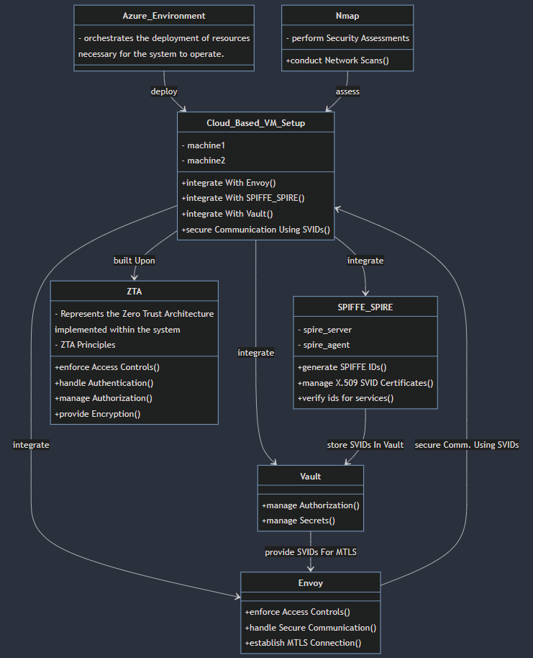
CONOP
Azure Environment:
Orchestrates the deployment of necessary resources for system operation.
Cloud-Based VM Setup:
Encompasses machine1 and machine2.
Integrates with Envoy, SPIFFE_SPIRE, and Vault.
Facilitates secure communication and management of identities and secrets.
SPIFFE_SPIRE:
Includes a SPIRE server and SPIRE agent.
Generates SPIFFE IDs and manages X.509 SVID certificates.
Verifies identities for services.
Vault:
Manages authorization and secrets securely.
Envoy:
Enforces access controls.
Handles secure communication.
Establishes mutual TLS connections.
Nmap:
Performs security assessments.
Conducts network scans to identify vulnerabilities.
ZTA (Zero Trust Architecture):
Represents the architectural principle.
Enforces access controls, authentication, authorization, and encryption.

Slide 30
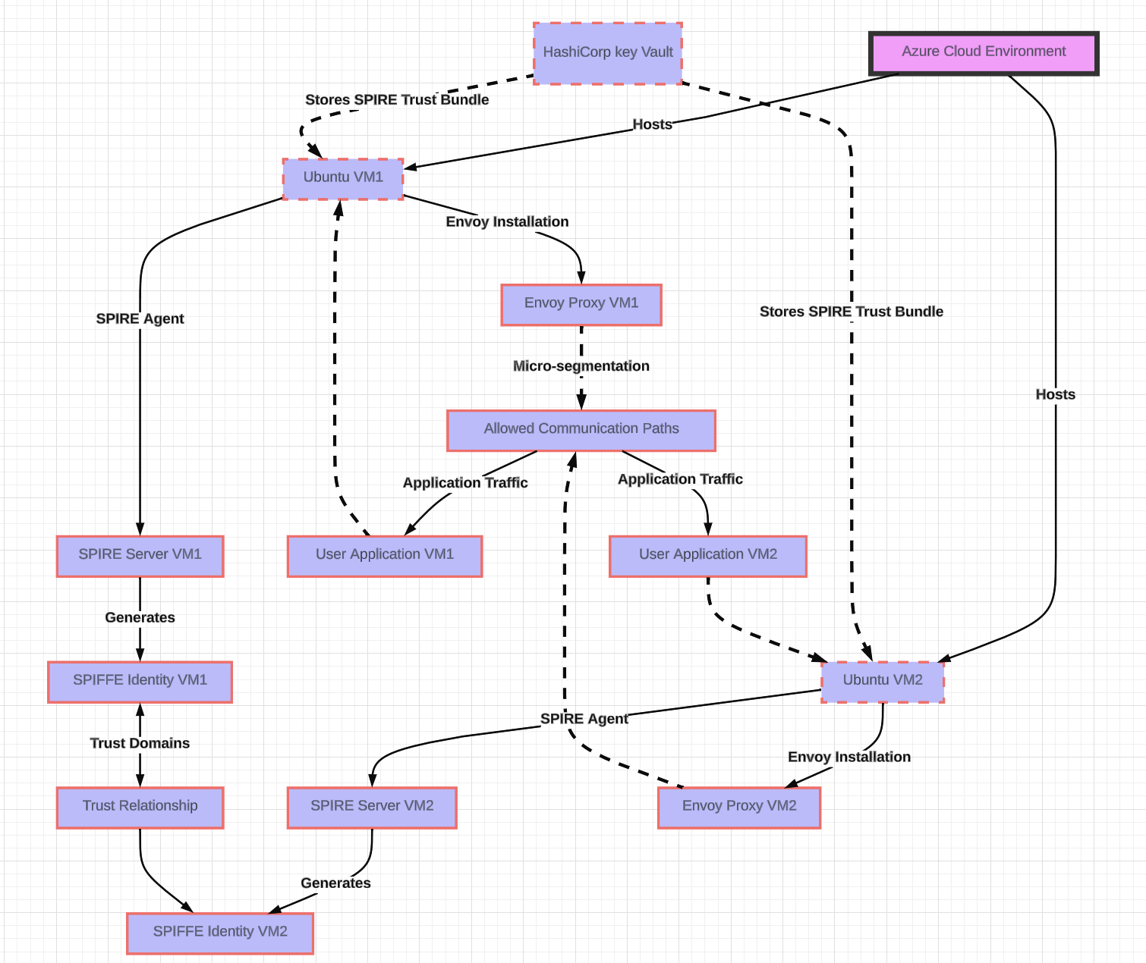
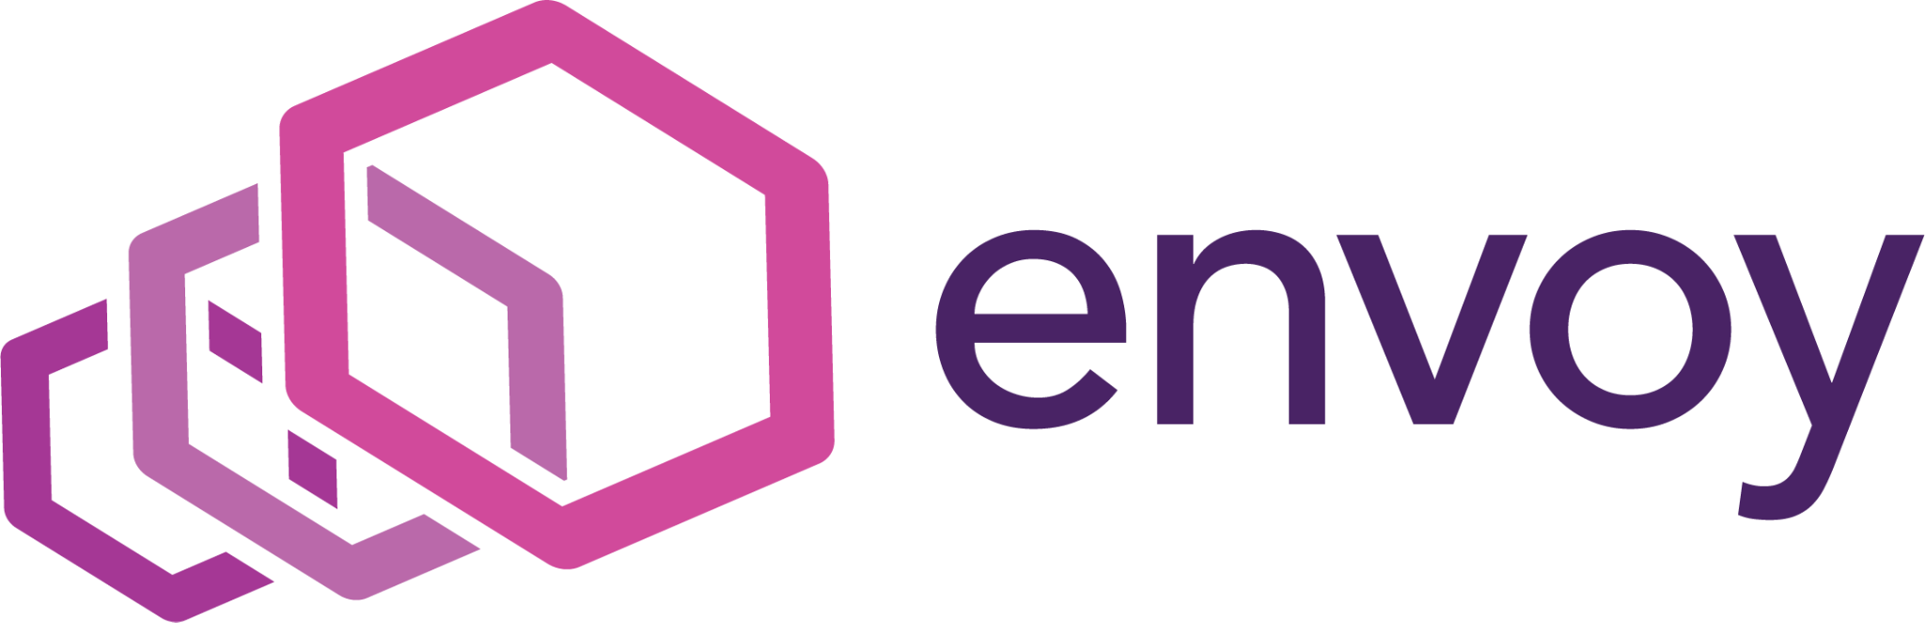
Implementation

Slide 31
Data Model:
Generate SPIRE Certificates
Envoy Retrieves SPIRE Certificates from Vault
HTTP Connections to the Envoy Instance are Logged
Store the SPIRE Certificates in Vault
Envoy Creates mTLS Connection using SPIRE Certifications
l

Slide 32


Why Azure?
Research Design
Seamless Integration: Azure integrates smoothly with other Microsoft Azure services, ensuring compatibility and simplifying implementation.
Robust Identity Management: Offers centralized user authentication, authorization, and access control, enabling granular access controls across cloud-native applications.
Scalability and Flexibility: Highly scalable to accommodate future growth and supports both cloud-only and hybrid identity scenarios.
Enhanced Security Features: Incorporates advanced security features like multi-factor authentication, conditional access policies, and identity protection capabilities.
Comprehensive Monitoring and Reporting: Provides insights into user activities, security events, and compliance status, facilitating proactive threat detection and compliance reporting.
https://shorturl.at/ALM27
https://shorturl.at/jxKPQ

Slide 33
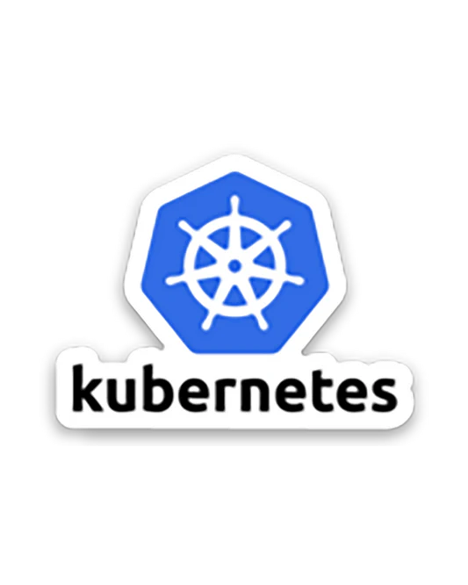




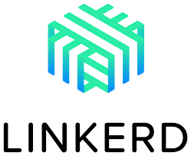

Researched CNCF Tools

Slide 34
How the Tools Can Be Used Pt.1
Kubernetes comes with Role-Based-Access-Control capabilities. Network policy implementation can determine how pods communicate with each other and outside services. IAM systems can also be integrated to consistently enforce authentication within clusters.
Helm enables audit logging in the Kubernetes environment and also has rollback features to revert dacomes with Role-Based-Access-Control capabilities. Network policy implementation can determine how pods communicate with each other and outside services. IAM systems can also be integrated to consistently enforce authentication within clusters.
mages. There are many implementable features which can run vulnerability scans and enable access control for users.
Falco is a tool that alerts on security threats, unusual behavior, and compliance violations. These features can be used to generate alerts if any Zero-Trust policies are compromised or violated.
Harbor is able to use Role-Based-Access-Control, check for vulnerabilities within an image, and sign trusted images and is designed to work with major cloud tools such as Kubernetes and Docker. This can be used to implement ZTA by implementing access control and ensuring all images are safe and signed as trusted.
Juny

Slide 35
How the Tools Can Be Used Pt.2
Linkerd is able to be used in ZTA because of its zero configuration mutual TLS and Zero-Trust Policy feature. This feature sets authorization policies that determine what type of traffic is able to reach meshed Kubernetes pods.
Network Service Mesh is a Hybrid/Multi-cloud IP Service Mesh and one of its key features is Layer 3 Zero Trust. This service can allow different workloads and databases interact with each other while maintaining Zero Trust.
Open Policy Agent provides a unified framework and approach to applying policies across cloud environments. Since a big part of ZTA is policy management, OPA assists this process by providing a standardized approach.
Istio is a service mesh that provides Traffic Management, Observability, and Security to Kubernetes clusters. In terms of security, Istio provides Role-Based-Access Control and authentication, two important aspects of ZTA.
SPIFFE and SPIRE provide identity management for cloud infrastructure. One of the key use cases of SPIFFE and SPIRE is cross service authentication for ZTA.
Ryan

Slide 36
Early Steps - Local VM Development
Emphasizing Azure VM Development for ZTA Architecture
During the early stages, the team divided their focus into two environments. Due to time restraints, the team decided to stop research on the local VM end and to completely shift the focus onto developing the Azure VMs. This was in the best interest for team and the overall story of implementing Cloud Native tools to generate the ZTA architecture as defined by the project guidelines.
The local VM team focused on incorporating CNCF tools such as Kubernetes, Calico, and Helm to create a secure environment which would later be connected to the Azure VMs through a S2S VPN connection(pFsense). From there, the team would be able to establish secure communications and demonstrate the overarching ZTA architecture over both environments.

Slide 37
Technical Approach
Local VM Environment Setup:
Local VM Project:
Create a new project on Oracle VirtualBox
Local VM Configuration:
Define the specifications of the VM
Download Ubuntu 22.04
Tool Installation:
Install necessary CNCF tools to create a ZTA environment
Network Segmentation and User Role Specification:
Install a tool to help ensure network isolation
Declare roles based on users using tools such as Kubernetes
Network Traffic
Implement tools to filter and/or monitor network traffic (Calico, Helm)
Ensure secure communication
Testing and Experimentation:
Test Environments:
Create multiple test environments to simulate different scenarios.
Testing Tools
Penetration testing to test security of the ZTA structure (Katoolin)
Scaling:
Test scalability of applications and infrastructure.
Documentation:
Document installation process and issues encountered
l

Slide 38
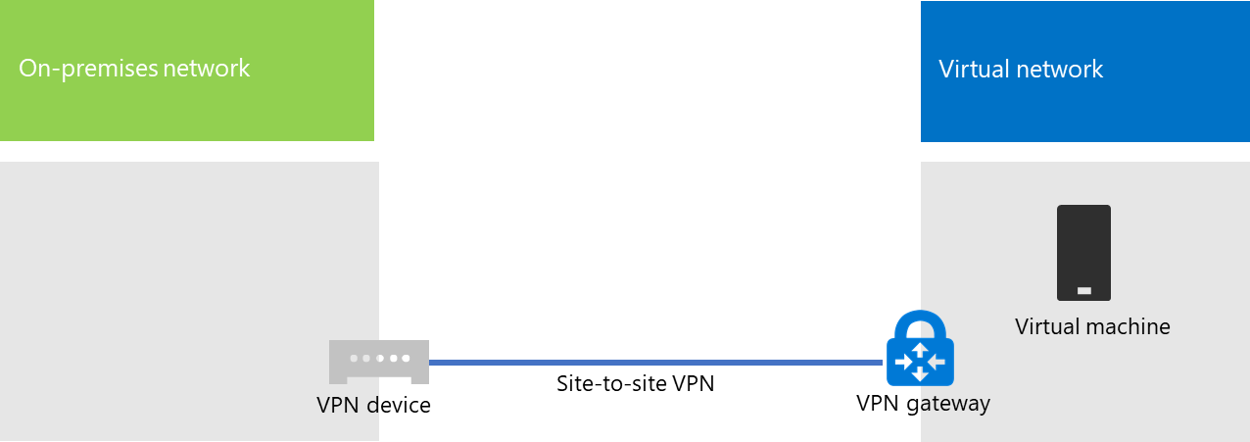
VPN Connection
Option1
Description: A VPN connection establishes an encrypted tunnel between an Azure virtual network and an on-premises location, facilitating secure communication over the public internet.
Benefits:
Simple to configure.
High aggregate bandwidth available; up to 10 Gbps depending on the VPN Gateway SKU.
Challenges:
Requires an on-premises VPN device.
Limited SLA coverage; Microsoft guarantees 99.9% availability for each VPN Gateway but not for the network connection to the gateway.
Connect an on-premises network to a Microsoft Azure virtual network - Microsoft 365 Enterprise | Microsoft Learn

Slide 39
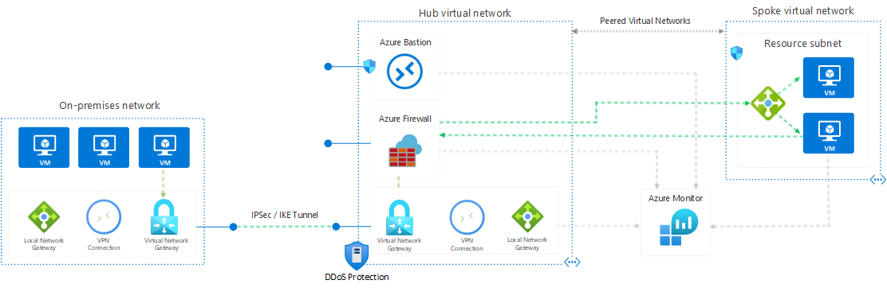
Example of secure hybrid network
Implement a secure hybrid network - Azure Architecture Center | Microsoft Learn

Slide 40
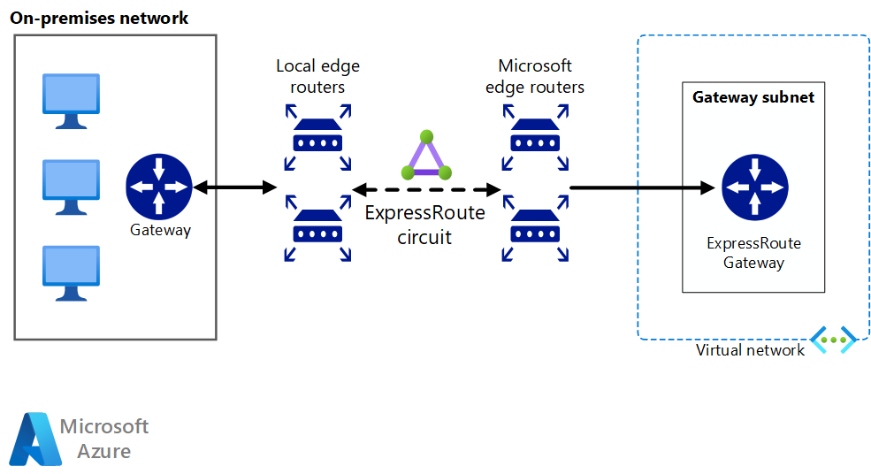
Azure ExpressRoute
Option 2
Description: Azure ExpressRoute provides a private, dedicated connection through a third-party connectivity provider, offering high bandwidth and lower latencies compared to typical internet connections.
Challenges:
Complexity in setup; requires working with a third-party connectivity provider.
Requires high-bandwidth routers on-premises.
On-premises network using ExpressRoute - Azure Architecture Center | Microsoft Learn

Slide 41
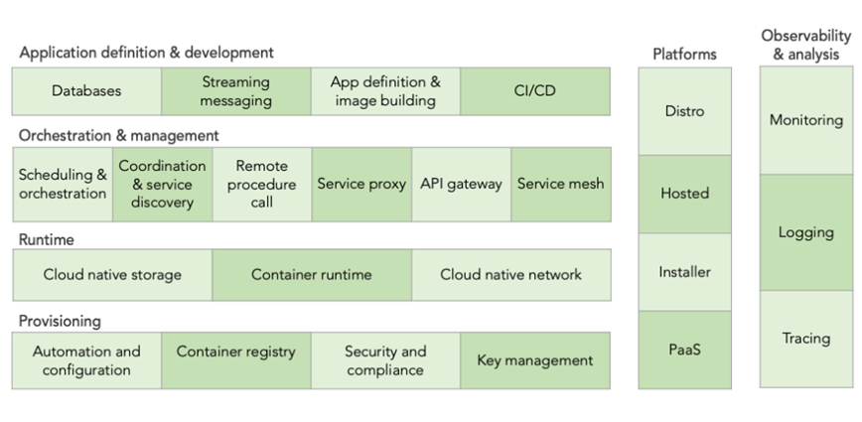
What is CNCF Landscape?
What are 6 Categories of CNCF?
Definition: The Cloud Native Computing Foundation (CNCF) Landscape is a visual representation of the various projects and tools that fall under the CNCF umbrella. It's designed to help navigate the ever-growing ecosystem of cloud-native technologies.
6 Categories of CNCF:

Slide 42
References
7 elements of highly successful zero trust architecture | video - zscaler. (2022, November 3).
Software AG. (n.d.). SPIFFE. Softwareag.com. Retrieved April 15, 2024, from https://techradar.softwareag.com/technology/spiffe-spire/
Getting Started — envoy 1.30.0-dev-1095be documentation. (n.d.). Envoyproxy.Io. Retrieved April 15, 2024, from https://www.envoyproxy.io/docs/envoy/latest/start/start
Your first secret. (n.d.). Your First Secret | Vault | HashiCorp Developer. Retrieved April 15, 2024, from https://developer.hashicorp.com/vault/tutorials/getting-started/getting-started-first-secret
CNCF landscape. (n.d.). Cncf.Io. Retrieved April 15, 2024, from https://landscape.cncf.io/
Cyber Law Toolkit. (n.d.). Microsoft Exchange Server data breach (2021). Retrieved from https://cyberlaw.ccdcoe.org/wiki/Microsoft_Exchange_Server_data_breach_(2021)

